Slide 1
DSP Lab10 Mel-frequency Cepstral Coefficients
劉奕汶、李祈均 老師
助教:周惶振、陳永慶、楊皓鈞、黃志翔

Slide 2
Flow chart
Pre-emphasis
Frame blocking
Fast Fourier Transform
Windowing
Triangular Band-pass filtering
Log energy
Discrete cosine transform
MFCC

Slide 3
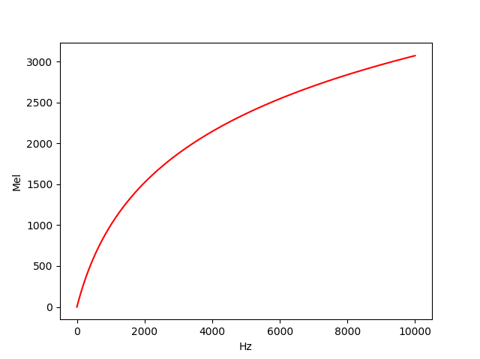
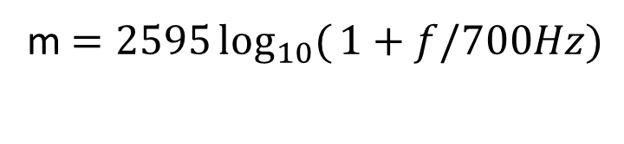
Mel-frequency to frequency
Hz | 40 | 161 | 200 | 404 | 693 | 867 | 1000 | 2022 | 3000 | 3393 | 4109 | 5526 | 6500 | 7743 | 12000
Mel | 43 | 257 | 300 | 514 | 771 | 928 | 1000 | 1542 | 2000 | 2142 | 2314 | 2600 | 2771 | 2914 | 3228
m $=2595\log_{10}({1+f/700Hz)}$

Slide 4
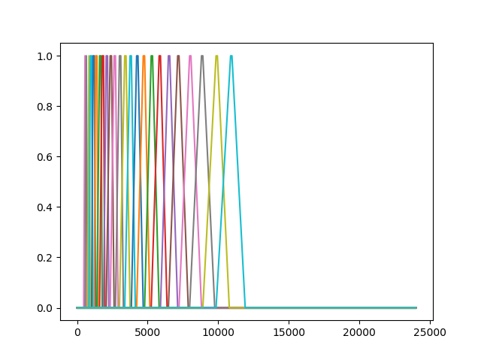
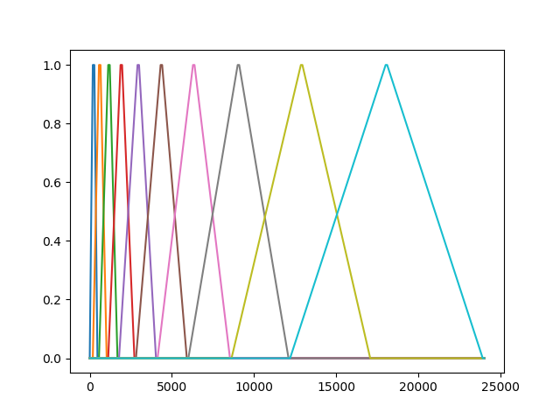
Triangular Band-pass filter

Slide 5
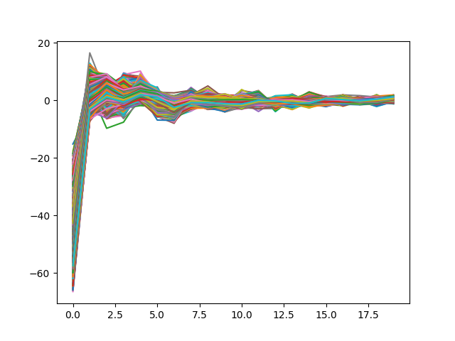
MFCC

Slide 6
Demo
Plot the signal and pre-emphasis signal.
Plot triangular Band-pass filter.
Record [ a ], [ i ], [ u ], [ɛ], [ɔ] and plot the their MFCC.

Slide 7
Report
Explain the meaning of pre-emphasis.
Compare the results of different numbers of filter numbers.
Do inverse MFCC and synthesis the audio(Bonus).

